Slide 1
Chapter II. Protocol Building Blocks

Slide 2
Chapter II.
Introduction to Protocols
Communications Using Symmetric Cryptography
One-Way Functions
One-Way Hash Functions
Communications Using Public-Key Cryptography
Digital Signatures
Digital Signatures with Encryption
Random and Pseudo-Random-Sequence Generation

Slide 3
What is a protocol?
A protocol is a series of steps, involving two or more parties, designed to accomplish a task.
A "series of steps" means that the protocol has a sequence, from start to finish. Every step must be executed in turn, and no step can be taken before the previous step is finished.
"Involving two or more parties" means that at least two people are required to complete the protocol;

Slide 4
The Purpose of Protocols
Fairness
Security
Anonymity

Slide 5
Players
Honest ones: Alice, Bob, Carol, Dave…
Eavesdropper: Eve
Active attacker: Mallory
Trusted arbitrator: Trent

Slide 6
Types of Protocols
Bob
Alice
Self-Enforcing Protocols

Slide 7
Types of Protocols
Self-enforcing protocols
It’s the best type of protocol.
No arbitrator is required
If one party tries to cheat, the other one can detect
The protocol will stop immediately.

Slide 8

Types of Protocols
Trent
Bob
Alice
Arbitrated Protocols

Slide 9
Types of Protocols
Arbitrated protocols
A trusted third party is involved and completes his own part of the protocol
He also helps Alice and Bob to finish the protocol.

Slide 10
Types of Protocols
Evidence
Evidence
Bob
Alice
Adjudicated Protocols

Slide 11
Types of Protocols
Adjudicated Protocols
It can be subdivided into two subprotocols.
Non arbitrated subprotocol
Arbitrated subprotocol
Arbitrated subprotocol is need to be executed only when there is a dispute.

Slide 12
Attacks Against Protocols
Against the cryptographic algorithms
Against the implement of the algorithms and protocols
Against the protocols themselves

Slide 13
Attacks Against Protocols
Passive attack
Eavesdropper can only eavesdrop the communication
He cannot affect the protocol
Active attack
An attacker could try to alter the protocol to his own advantage. He could pretend to be someone else, introduce new messages in the protocol, delete existing messages, substitute one message for another, replay old messages, interrupt a communications channel, or alter stored information in a computer

Slide 14
Communications Using Symmetric Cryptography
(1) Alice and Bob agree on a cryptosystem.
(2) Alice and Bob agree on a key.
(3) Alice takes her plaintext message and encrypts it using the encryption algorithm and the key. This creates a ciphertext message.
(4) Alice sends the ciphertext message to Bob.
(5) Bob decrypts the ciphertext message with the same algorithm and key and reads it.

Slide 15
Communications Using Symmetric Cryptography
Problems:
Keys must be distributed in secret.
If a key is compromised, then Eve can decrypt all message traffic encrypted with that key.
The total number of keys increases rapidly as the number of users increases.
Any solutions to this problem

Slide 16
One way functions
It is the key point of a public-key cryptosystem
Given x, it is easy to compute f (x)
But given f (x) , it is hard to compute x.
What is hard?
Processing complexity

Slide 17
One way functions
Trapdoor one way function:
A special type of one way function.
Given x, it is easy to compute f (x)
Given f (x) , it is hard to compute x.
But with some secret information y, it is easy to compute x

Slide 18
One way hash functions
Hash function :
It takes a variable-length input string (pre-image) and converts it to a fixed-length output string.
One way hash function:
It works in one direction.
For a given value x, it is easy to compute it’s hash value H(x)
But given an H(x), it is hard to compute x.
Also known as MDC (Manipulation Detection Code)

Slide 19
One way hash functions
Properties of a good one way function:
Pre-image resistance—for essentially all pre-specified outputs, it is computationally infeasible to find any input which hashes to that output.
2nd-preimage resistance—it is computationally infeasible to find any second input which has the same output as any specified input.
collision resistance—it is computationally infeasible to find any two distinct inputs x, x’, which hash to the same output.

Slide 20
Messages authentication code
A one way hash function with the addition of a secret key.
It should has the same properties as the MDC

Slide 21
Communications Using Public-Key Cryptography
(1) Alice and Bob agree on a public-key cryptosystem.
(2) Bob sends Alice his public key.
(3) Alice encrypts her message using Bob’s public key and sends it to Bob.
(4) Bob decrypts Alice’s message using his private key.

Slide 22
Communications Using Public-Key Cryptography
(1) Alice gets Bob’s public key from the database.
(2) Alice encrypts her message using Bob’s public key and sends it to Bob.
(3) Bob then decrypts Alice’s message using his private key.

Slide 23
Hybrid cryptosystem
(1) Bob sends Alice his public key.
(2) Alice generates a random session key, K, encrypts it using Bob’s public key, and sends E_{B}(K ) to Bob
(3) Bob decrypts Alice’s message using his private key to recover the session key.
D_{B}(E_{B}(K )) = K
(4) Both of them encrypt their communications using the same session key.

Slide 24
Digital Signatures
Properties of a signature
Authentic
The signature convinces the document’s recipient that the signer deliberately signed the document.
Un-forgeable
The signature is proof that the signer, and no one else, deliberately signed the document
Not reusable
The signature is part of the document
The signed document is unalterable
After the document is signed, it cannot be altered
Cannot be repudiated
The signer cannot later claim that he or she didn’t sign it.

Slide 25
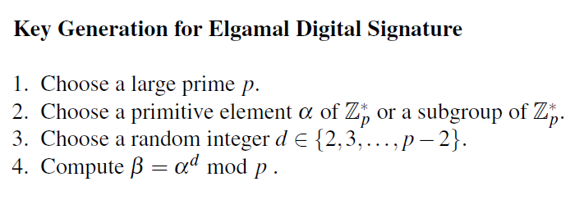
The Elgamal digital signature scheme

Slide 26
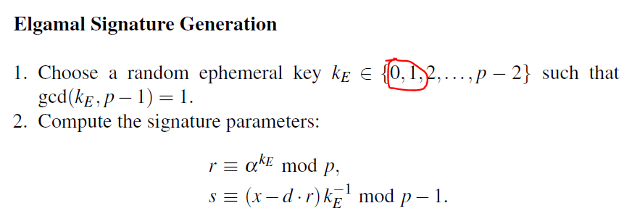

The Elgamal digital signature scheme

Slide 27
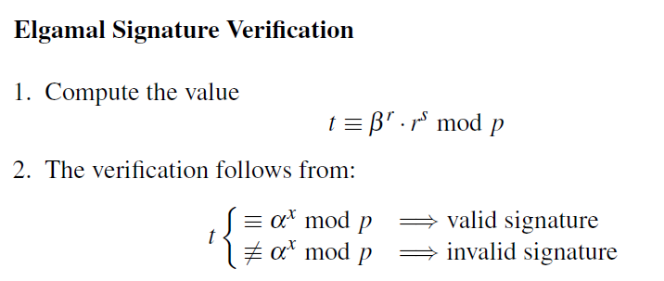
The Elgamal digital signature scheme

Slide 28
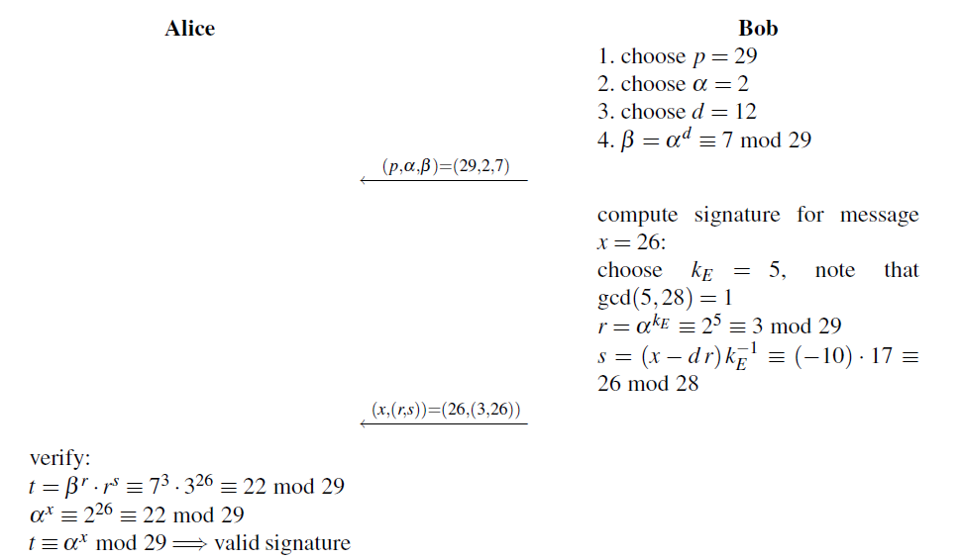
The Elgamal digital signature scheme

Slide 29
The Elgamal digital signature scheme
Computational Aspects
p should have a length of at least 1024 bits.
The private key d should be generated by a true random number generator. The public key β requires one exponentiation using the square-and-multiply algorithm
The signature consists of the pair (r, s)，about two times as long as only the message x.
Computing r requires an exponentiation modulo p
The main operation when computing s is the inversion of kE
The verifier performs two exponentiations

Slide 30
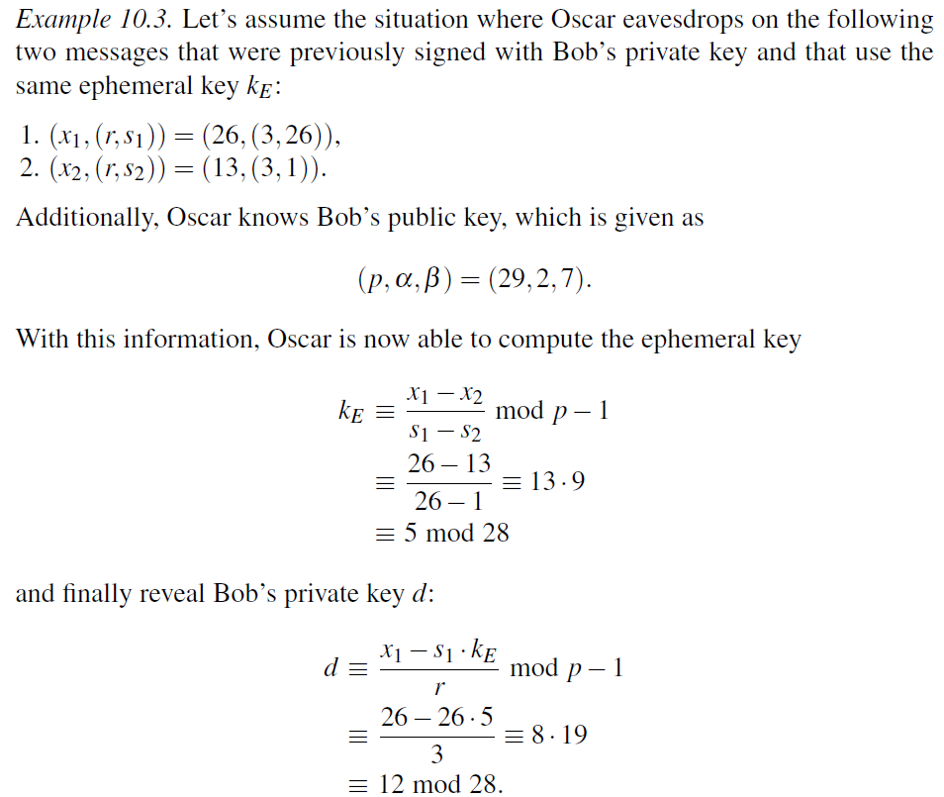
The Elgamal digital signature scheme
Reuse of Ephemeral Key

Slide 31
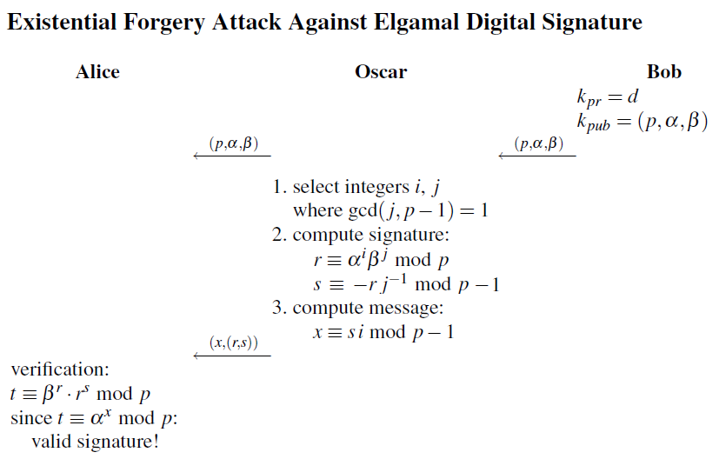
The Elgamal digital signature scheme

Slide 32
Content of this Chapter
The principle of digital signatures
Security services
The RSA digital signature scheme
The Elgamal digital signature scheme
The Digital Signature Algorithm (DSA)

Slide 33
Digital Signature Algorithm (DSA)
Federal US Government standard for digital signatures (DSS)
Proposed by NIST
DSA is based on the Elgamal signature scheme
Signature is only 320 bits long
Free from some attacks that can threaten Elgamal
Signature verification is slower compared to RSA

Slide 34
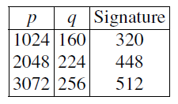
Digital Signature Algorithm (DSA)
Key generation of DSA:
Generate a prime p with 2¹⁰²³ < p < 2¹⁰²⁴
Find a prime divisor q of p-1 with 2¹⁵⁹ < q < 2¹⁶⁰
Find an integer α with ord(α)=q
Choose a random integer d with 0<d<q
Compute β ≡ α^{d} mod p
The keys are:
k_{pub} = (p,q,α,β)
k_{pr} = (d)

Slide 35
Digital Signature Algorithm (DSA)
DSA signature generation :
Given: message x, private key d and public key (p,q,α,β)
Choose an integer as random ephemeral key k_{E} with 0<k_{E}<q
Compute r ≡ (α^{kE} mod p) mod q
Computes s ≡ (SHA(x)+d ∙ r) k_{E}⁻¹ mod q
The signature consists of (r,s)
SHA denotes the hashfunction SHA-1 which computes a 160-bit fingerprint of message x.

Slide 36
Digital Signature Algorithm (DSA)
DSA signature verification
Given: message x, signature (s, r) and public key (p,q,α,β)
Compute auxiliary value w ≡ s⁻¹ mod q
Compute auxiliary value u₁ ≡ w ∙ SHA(x) mod q
Compute auxiliary value u₂ ≡ w ∙ r mod q
Compute v ≡ (α^{u1} ∙ β ^{u2} mod p) mod q
If v ≡ r mod q → signature is valid
If v ≡ r mod q → signature is invalid

Slide 37
Proof of DSA:
We need to show that the signature (r,s) in fact satisfied r ≡ v mod q:
s ≡ (SHA(x))+d ∙r)k_{E} ⁻¹ mod q
⬄ k_{E} ≡ s⁻¹ SHA(x) + ds⁻¹ r mod q
⬄ k_{E} ≡u₁+du₂ mod q
We can raise α to either side of the equation if we reduce modulo p:
⬄ α^{kE} mod p ≡ α^{u1+d∙u2} mod p
Since β ≡ α^{d} mod p we can write:
⬄ α^{kE} mod p ≡ α^{u1}β^{u2} mod p
We now reduce both sides of the equation modulo q:
⬄ (α^{kE} mod p) mod q ≡ (α^{u1}β^{u2} mod p) mod q
Since r ≡ α^{kE} mod p mod q and v ≡ (α^{u1}β^{u2} mod p) mod q:
⬄ r ≡ v

Slide 38
Example
Alice
Bob
Key generation:
choose p = 59 and q = 29
choose α = 3
choose private key d = 7
β = α^{d} = 3⁷ ≡ 4 mod 59
Sign:
Compute has of message H(x)=26
Choose ephermal key k_{E}=10
r = (3¹⁰ mod 59) ≡ 20 mod 29
s = (26 + 7 ∙ 20) ∙ 3) ≡ 5 mod 29
(p, q, α, β)=(59, 29, 3, 4)
(x,(r, s))=(x,20, 5)
Verify:
w ≡ 5⁻¹ ≡ 6 mod 29
u₁ ≡ 6 ∙ 26 ≡ 11 mod 29
u₂ ≡ 6 ∙ 20 ≡ 4 mod 29
v = (3¹¹ ∙ 4⁴ mod 59) mod 29 = 20
v ≡ r mod 29 → valid signature

Slide 39
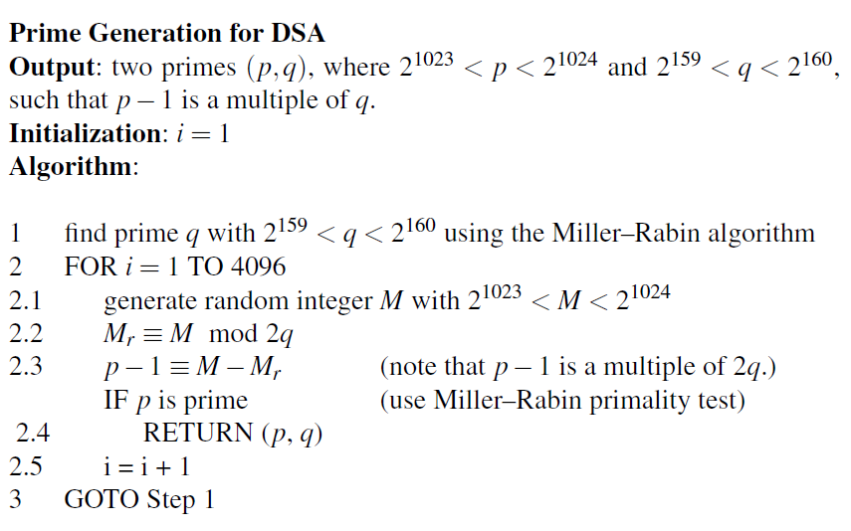
Digital Signature Algorithm (DSA)

Slide 40
Security of DSA
To solve the discrete logarithm problem in p the powerful index calculus method can be applied. But this method cannot be applied to the discrete logarithm problem of the subgroup q. Therefore q can be smaller than p.
p | q | hash output (min) | security levels
1024 | 160 | 160 | 80
2048 | 224 | 224 | 112
3072 | 256 | 256 | 128
DSA is vulnerable if the ephemeral key is reused

Slide 41
Signature with Symmetric Cryptosystems and an Arbitrator
(1) Alice encrypts her message to Bob with K_{A} and sends it to Trent.
(2) Trent decrypts the message with K_{A}.
(3) Trent takes the decrypted message and a statement that he has received this message from Alice, and encrypts the whole bundle with K_{B}.
(4) Trent sends the encrypted bundle to Bob.
(5) Bob decrypts the bundle with K_{B}. He can now read both the message and Trent’s certification that Alice sent it.

Slide 42
Properties of this scheme
Authentic
Un-forgeable
Not reusable
The signed document is unalterable
Cannot be repudiated

Slide 43
Signature with Symmetric Cryptosystems and an Arbitrator
If Bob wants to show Carol a document signed by Alice. How can he achieve this goal?
(1) Bob takes the message and Trent’s statement that the message came from Alice, encrypts them with K_{B}, and sends them back to Trent.
(2) Trent decrypts the bundle with K_{B}.
(3) Trent checks his database and confirms that the original message came from Alice.
(4) Trent re-encrypts the bundle with the secret key he shares with Carol, K_{C}, and sends it to Carol.
(5) Carol decrypts the bundle with K_{C}. She can now read both the message and Trent’s certification that Alice sent it.

Slide 44
Signature using Public-Key Cryptography
(1) Alice encrypts the document with her private key, thereby signing the document.
(2) Alice sends the signed document to Bob.
(3) Bob decrypts the document with Alice’s public key, thereby verifying the signature.

Slide 45
Signature using Public-Key Cryptography and one way Hash Function
Any problems with the signature using public-key cryptosystem?
Efficiency
Any solutions?

Slide 46
Signature using Public-Key Cryptography and one way Hash Function
(1) Alice produces a one-way hash of a document.
(2) Alice encrypts the hash with her private key, thereby signing the document.
(3) Alice sends the document and the signed hash to Bob.
(4) Bob produces a one-way hash of the document that Alice sent. He then, using the digital signature algorithm, decrypts the signed hash with Alice’s public key.

Slide 47
Multiple Signatures
Question:
How can Alice and Bob sign the same document?

Slide 48
Multiple Signatures
(1) Alice signs the hash of the document.
(2) Bob signs the hash of the document.
(3) Bob sends his signature to Alice.
(4) Alice sends the document, her signature, and Bob’s signature to Carol.
(5) Carol verifies both Alice’s signature and Bob’s signature.

Slide 49
Nonrepudiation
Repudiation Deny something that you have ever done.

Slide 50
Nonrepudiation
(1) Alice signs a message.
(2) Alice generates a header containing some identifying information. She concatenates the header with the signed message, signs that, and sends it to Trent.
(3) Trent verifies the outside signature and confirms the identifying information. He adds a timestamp to Alice’s signed message and the identifying information. Then he signs it all and sends it to both Alice and Bob.
(4) Bob verifies Trent’s signature, the identifying information, and Alice’s signature.
(5) Alice verifies the message Trent sent to Bob. If she did not originate the message, she speaks up quickly.

Slide 51
Signatures with encryption
(1) Alice signs the message with her private key S_{A}(M )
(2) Alice encrypts the signed message with Bob’s public key and sends it to Bob, E_{B}(S_{A}(M ))
(3) Bob decrypts the message with his private key D_{B}(E_{B}(S_{A}(M ))) = S_{A}(M )
(4) Bob verifies with Alice’s public key and recovers the message, V_{A}(S_{A}(M )) = M

Slide 52
Signatures with encryption
Any weakness with this scheme?

Slide 53
Resending the Message as a Receipt
Alice signs a message with her private key, encrypts it with Bob’s public key, and sends it to Bob. E_{B}(S_{A}(M ))
Bob decrypts the message with his private key and verifies the signature with Alice’s public key, thereby verifying that Alice signed the message and recovering the message. V_{A}(D_{B}(E_{B}(S_{A}(M)))) = M
Bob signs the message with his private key, encrypts it with Alice’s public key, and sends it back to Alice. E_{A}(S_{B}(M ))
Alice decrypts the message with her private key and verifies the signature with Bob’s public key. If the resultant message is the same one she sent to Bob, she knows that Bob received the message accurately.

Slide 54
How to attack this protocol?
If the same algorithm is used for both encryption and digital-signature verification there is a possible attack.
How to prevent?

Slide 55
Random and Pseudo-Random-Sequence Generation
Anyone who considers arithmetical methods of producing random digits is, of course, in a state of sin
--John Von Neumann

Slide 56
How to produce random numbers
Physic way
Noise voltage
Package numbers sent from network interface card
…
Simulation way
Middle-square method
Linear congruent method
ANSI X9.17
Linear feedback shift register
RSA

Slide 57
Linear congruent
For example.
But how about:

Slide 58
Other congruent method

Slide 59
What is a good pseudo-random number
It looks random. This means that it passes all the statistical tests of randomness that we can find
It is unpredictable. It must be computationally infeasible to predict what the next random bit will be, given complete knowledge of the algorithm or hardware generating the sequence and all of the previous bits in the stream.
It cannot be reliably reproduced

Slide 60
ANSI X9.17
By means of DES.
E_{K}(T) = I
E_{K}(XOR (I, S))=R₁Where S is a secret seed
E_{K}(XOR (R₁, I)) = S_{1,} Which is using for the next secret seed.

Slide 61
linear feedback shift register

Slide 62
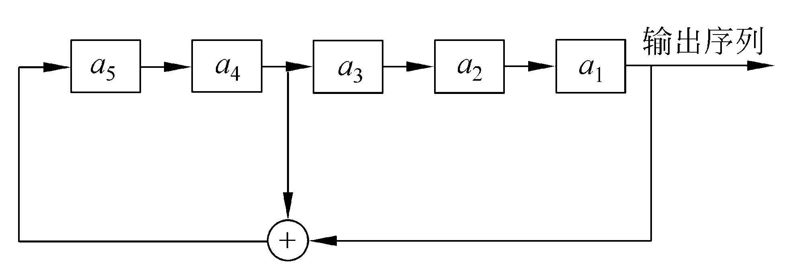
linear feedback shift register
For example, the initial conditions are
（a₁,a₂,a₃,a₄,a₅）=(1,0,0,1,1),
then what is the output?

Slide 63
Notes:
增加其他的移位寄存器，手稿板书

Slide 64
RSA Method
Produce a l-bits sequence by means of RSA method
Choose p, q, compute n=pq,
choose a proper e.
Choose a secret x between 1 and n-1as the seed
Compute , the lowest bit is the first output
Let y=x

Slide 65
Discrimination of good pseudo-random number (sequences)
By mathematic method
Statistical test
Parameter test
Frequency test
χ² test
K-S test
Monobit test
Run-length test

Slide 66
Notes:
增加一些例子和方法的详细介绍。手稿板书

